Slide 1
National Income Accounting

Slide 2
An Overview of Macroeconomics
Economics
Microeconomics
Macroeconomics
Study of economic issues/problems at individual level
Example: Individual demand and individual supply
Study of economic issues/problems as a whole
Example: Aggregate demand and aggregate supply
Notes:
Microeconomics and macroeconomics are two branches of economics that study different aspects of the economy at different levels.
Microeconomics:
Microeconomics focuses on the behavior and decisions of individual agents within the economy, such as households, firms, and industries. It examines how these individual actors make decisions regarding the allocation of resources and how their interactions influence prices, quantities, and the distribution of goods and services. Microeconomics deals with specific economic issues like supply and demand, consumer behavior, production costs, market structures (perfect competition, monopoly, oligopoly, etc.), and factors affecting individual firms' decision-making.
Example: Microeconomics would analyze how a change in the price of a particular good, such as smartphones, affects the demand for that product and how individual smartphone manufacturers adjust their production levels and pricing strategies in response to changes in market conditions.
Macroeconomics:
Macroeconomics studies the economy as a whole, focusing on aggregate measures such as total output (Gross Domestic Product or GDP), unemployment rates, inflation, and overall economic growth. It investigates the broader economic phenomena that affect entire nations or regions, including factors like fiscal policy, monetary policy, international trade, and economic indicators. Macroeconomics examines the relationships between different macroeconomic variables and how government policies, central bank actions, and external shocks impact the overall performance of the economy.Example: Macroeconomics would analyze how changes in government spending or interest rates affect overall economic output, unemployment rates, and inflation. For instance, it might study how a government's decision to increase infrastructure spending influences GDP growth and job creation across various sectors of the economy.
In summary, while microeconomics focuses on individual economic units and their interactions, macroeconomics looks at the economy as a whole and analyzes broad economic trends and policies that affect entire populations or nations.

Slide 3
Circular Flow of Income
The circular flow model demonstrates how money moves from producers to households and back again in an endless loop.
In an economy, money moves from producers to workers as wages and then back from workers to producers as workers spend money on products and services.
The models can be made more complex to include additions to the money supply, like exports, and leakages from the money supply, like imports.
When all of these factors are totaled, the result is a nation's gross domestic product (GDP) or the national income.
Analyzing the circular flow model and its current impact on GDP can help governments and central banks adjust monetary and fiscal policy to improve an economy.
Notes:
The basic purpose of the circular flow model is to understand how money moves within an economy. It breaks the economy down into two primary players: households and firms (considering that there are two sectors in the economy). It separates the markets that these participants operate in as markets for goods and services and the markets for the factor of production. Other sectors can be added for more robust cash flow tracking.
The circular flow model is used to measure a nation's income, as the circular flow model measures both cash coming into and exiting a nation's economy. It is also used to gauge the interconnectivity between sectors as a fully robust and strong economy will have interaction between components. For instance, the relationship between a government's taxation policies and a household's consumption spending will have a direct impact on a business's ability to sell goods.
The two-sector circular flow of income is a simplified economic model that illustrates the flow of money and goods between households and firms within an economy. In this model, there are two main sectors: households and firms.
Households: Households are the ultimate consumers of goods and services in the economy. They supply factors of production, such as labor, land, and capital, to firms in exchange for income.
Firms: Firms are the producers of goods and services in the economy. They use factors of production supplied by households to produce goods and services, which they then sell to households.
The circular flow of income between households and firms can be depicted as follows:
Households provide factors of production (land, labor, capital) to firms in exchange for income (wages, rent, interest, profits).
Firms use these factors of production to produce goods and services, which they then sell to households.
Households spend their income on purchasing goods and services produced by firms, completing the circular flow.
Now, let's discuss the concepts of leakage and injection in the context of this model:
Leakage: Leakage refers to any withdrawal of funds from the circular flow of income. The three main forms of leakage are savings, taxes, and imports.
Savings: When households save a portion of their income rather than spending it on goods and services, it constitutes a leakage from the circular flow. The saved funds are not immediately returned to firms as spending.
Injection: Injection refers to any addition of funds to the circular flow of income, offsetting leakages. The three main forms of injection are investment, government spending, and exports.
Investment: When firms use funds to invest in capital goods, such as machinery, equipment, or infrastructure, it constitutes an injection into the circular flow. Investment adds to the total spending in the economy and creates income for households.
In summary, leakages and injections affect the economy by influencing the level of aggregate demand and the overall equilibrium level of income and output. When injections exceed leakages, the economy experiences growth, while if leakages exceed injections, the economy may contract. Policymakers often use fiscal and monetary policies to manage leakages and injections to achieve macroeconomic stability and promote economic growth.
If leakages and injections are not equal in an economy, it can lead to imbalances that affect the overall level of economic activity and potentially disrupt the equilibrium in the circular flow of income.
Leakages Greater Than Injections:
If leakages (savings) exceed injections (investment), it indicates that there is more money being withdrawn from the circular flow of income than being added. This situation can lead to a decrease in aggregate demand because households and firms are saving more, paying higher taxes, or spending more on imports than what is being invested, spent by the government, or earned from exports. A decrease in aggregate demand can result in reduced output, income, and employment levels in the economy, potentially leading to a recession or economic downturn. To address this imbalance, policymakers might implement expansionary fiscal or monetary policies to increase injections into the economy, such as reducing taxes, increasing government spending, or lowering interest rates to stimulate investment and consumption.
Injections Greater Than Leakages:
Conversely, if injections (investment) exceed leakages (savings), it indicates that there is more money being injected into the circular flow of income than being withdrawn. This situation can lead to an increase in aggregate demand because households and firms are spending more, paying fewer taxes, or importing less than what is being invested, spent by the government, or earned from exports. An increase in aggregate demand can result in higher levels of output, income, and employment in the economy, potentially leading to inflationary pressures. To address this imbalance, policymakers might implement contractionary fiscal or monetary policies to reduce injections into the economy, such as increasing taxes, decreasing government spending, or raising interest rates to dampen investment and consumption.
In summary, when leakages and injections are not equal, it can lead to economic imbalances that affect overall economic activity, output, income, and employment levels. Policymakers aim to manage these imbalances through appropriate fiscal and monetary policies to maintain macroeconomic stability and promote sustainable economic growth.

Slide 4
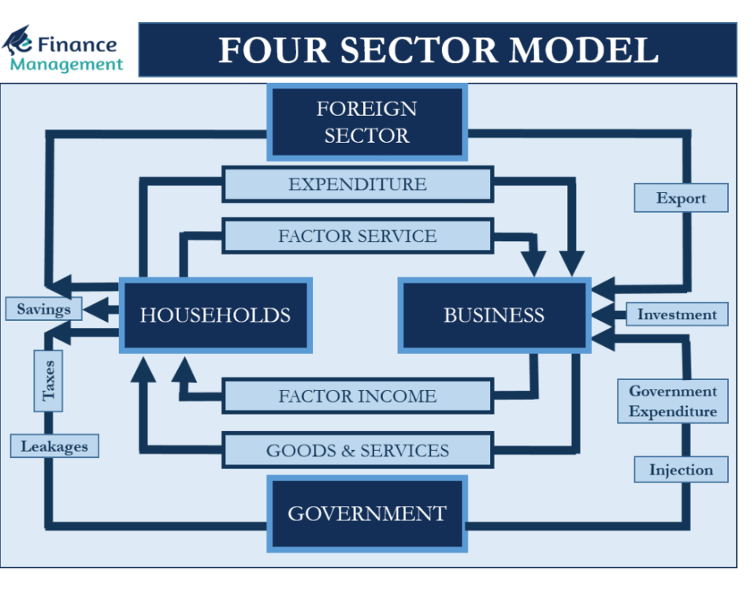
Notes:
The Four Sector Circular Flow Income Model is the most realistic one under the current world conditions. In a circular flow of income, every sector plays a dual role. Each sector not only gets a payment from other sectors but pays them as well in one form or another. Thus, understanding the circular flow of income and expenditure in an economy is very important, and one of the best models that explain it is the four-sector model.
This model is realistic and practical as it consists of four primary sectors. These sectors are households, businesses, the government, and the foreign sector (or the rest of the world). The foreign sector primarily means the export and import of goods and services. Therefore, this Four Sector Model is also called an Open Economy Model. In the Four Sector Model, imports are treated as expenditure and become a leakage. Whereas exports boost the national income and are treated as injection.
Assumptions:
This model drops the unrealistic assumptions of the two- and three-sector models. Following are the assumptions of a four-sector model:
The entry and recognition of the Foreign Sector in this model leads to no restrictions on the import and export in general. Specific restrictions like the trading country, product, etc may be there.
The Government intervention is minimal.
Both domestic and foreign markets feature perfect competition.
Household exports labor and capital, while businesses export goods and services.
Let us understand each sector’s role (income and expenditure) in detail to better understand the four-sector model.
Household Sector
The Household Segment plays a critical role in the Economic Development of any Country. This sector acts as:
A producer: Small businesses – self-employed and family businesses does make some products and sell the same. And gets money from other sectors by selling these goods and services.
Works as a factor of production: They provide resources to the businesses as well as the public in the form of labor, professionals-Doctors, Engineers, Lawyers, Consultants, etc. They earn income in the form of rent on owned properties, fees, and remuneration for the work and services provided to other sectors as well as to the household segment.
Transfer payments: This segment also gets various transfer payments from the government in the form of subsidies, welfare activities, and so on.
Acts as a consumer: households consume various goods and services produced and sold by the businesses. The major outgo of the household segment is in the form of consumption only. They also pay for the imports of goods and services.
Pays taxes to the Government: Besides the businesses, the households form a large chunk, rather than the biggest chunk of taxpayers to the government. They pay direct taxes in the form of income tax, wealth tax, gift tax, etc. They also pay indirect taxes in the form of VAT, Sales Tax, Service Tax, GST, etc.
Act as Saver: Households are the biggest block of savers and investors in an economy. Every other segment-businesses and the government try to woe their savings. The money left over from their income, after fulfilling all their consumption needs, is saved. These savings get deposited with banks and financial institutions. Part of it also goes for investment in the stock market, real estate, bullion, and so on.
Business Sector
Businesses get revenue from selling goods and services to households, as well as through exports. They also get subsidies from the government.
On the other hand, payments from businesses to other sectors include factor payments, taxes, import payments, and more.
Government Sector
The segment includes two types of activities. The First one is the governance, welfare activities, services, and so on. The second segment is where the government owns and operates certain businesses.
The primary income source for the government is tax collections from households and businesses. Also, the government gets interests and dividends from investing in businesses, as well as international grants and loans.
On the other hand, payment from the government includes transfer payments, subsidies, grants, and more. The transfer payments involve sending money to households through pension funds, scholarships, and more. Also, the government buys goods and services from businesses.
Foreign Sector
This sector gets income from businesses, governments, and households who import goods and services from other countries. On the other hand, the foreign sector makes payments to businesses and governments when they export goods and services to other countries. It also makes factors payment to households.
In the case of exports being more than imports, there is a surplus balance of payment. And, when the imports exceed exports, there is a deficit balance of payment in the economy. The government uses different policies to maintain a balance between imports and exports.

Slide 5
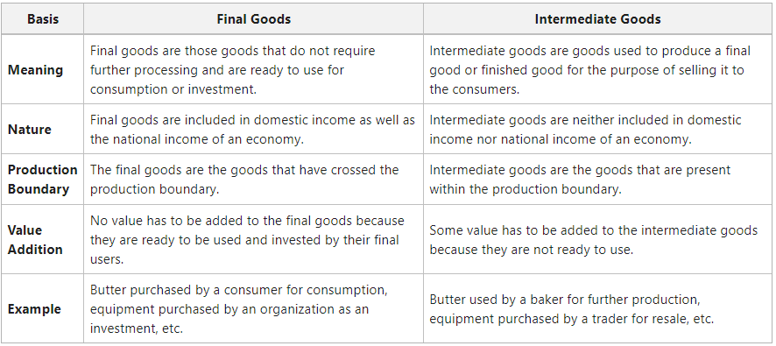
Types of goods
Notes:
Final goods are those goods that do not require further processing and are ready to use. These goods are also called consumer goods and are manufactured for the purpose of direct use by the end consumer. In a nutshell, final goods are products that are manufactured by a company for consumption by the consumer in the coming time. These goods aim to satisfy the needs or wants of a consumer. Final goods are neither resold nor used for further transformation in production.
Final goods consist of the following:
Goods that are purchased by the local households are meant for final consumption. For example, television, milk, ready-to-eat foods, medicines, etc. It also consists of the goods that are bought by the organizations for investment purposes or the formation of capital.
Intermediate goods are goods used to produce a final good or finished good for the purpose of selling it to the consumers. Intermediate goods like salt can be a finished product, as it is consumed directly by consumers and can be used by producers to produce other food products. Intermediate goods are sold between industries for the resale purpose or for the production of other goods. These goods are also called semi-finished products, as they are used as inputs to manufacture finished products. There are normally three choices for the use of intermediate goods. A producer may produce and use their own intermediate goods. The producer may also sell them, which is most commonly practiced between industries. Companies purchase intermediate goods for particular use in producing either a secondary intermediate product or in producing the finished product. Usually, all intermediate goods are either a part of the final product or are totally reconfigured during the production process.
Some facts about Intermediate Goods
Intermediate goods remain within the production boundary, i.e., these are purchased by one production unit from another production unit. However, every purchase of goods by one production unit from another is not an intermediate purchase of goods. It means that if a good is purchased for investment purposes and not for the purpose of resale, then they are termed as final goods. For example, goods like machinery, etc., are purchased by one production unit from another for the purpose of production. Also, their value is not added to the value of the final good; therefore, these goods are not termed as intermediate goods, but as final goods.
As the demand for an intermediate good depends upon the demand of the final good in the market, it has a Derived Demand.
3. Usually durable goods are considered final goods, but the durable goods purchased by the Government for the military, such as vehicles, aircraft, trucks, etc., are considered intermediate goods. It is because these goods help in producing defense services and are not for sale in the market.
4. The value of an intermediate good is merged with the value of the final good. For example, if a production unit purchases cotton worth ₹500 and converts it into thread worth ₹800, then the value of the final good (thread) includes the value of the intermediate good (cotton).
5. The goods which are used up in the same year are considered intermediate goods. If a product remains unused for more than one year, it will be treated as a final good. For example, ABC Ltd. purchases 20 tonnes of wood in 2021 for making furniture. Only 12 tonnes of wood was used up in 2021, and the remaining 8 tonnes of wood was carried forward in 2022. Now 12 tonnes of wood will be taken as intermediate goods, and 8 tonnes of wood will be considered as final goods. Also, the value of 8 tonnes of wood will be included in National Income.

Slide 6
Review Question
Question: Classify the following items as final or intermediate goods
Furniture purchased by a school (Final)
Computer installed in an office (Final)
Mobile set purchased by the mobile dealer (Intermediate)
Paper purchased by a publisher (Intermediate)
Unsold coal at the trader at the year end (Final)

Slide 7
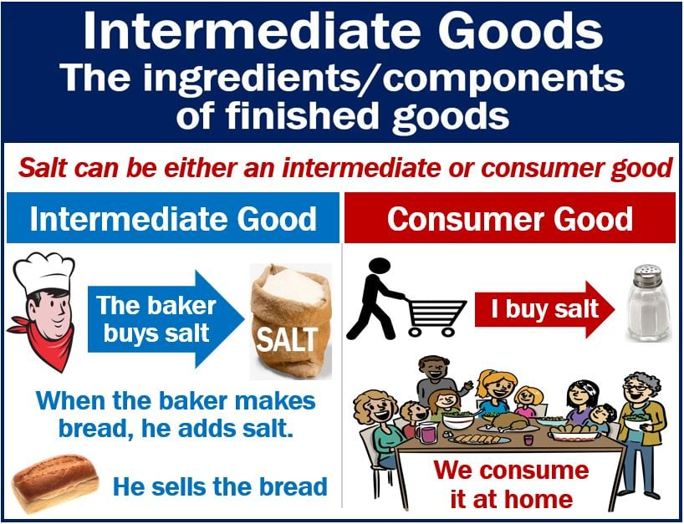
Can intermediary good be final good?

Slide 8
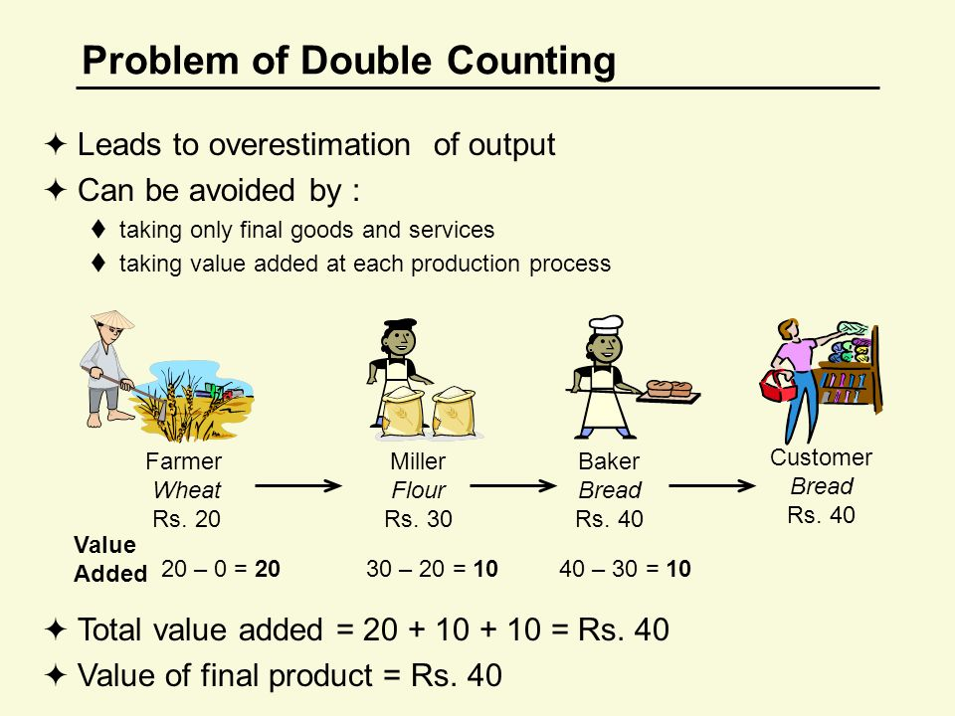
Double counting problem: how to avoid it?
Notes:
The double counting problem refers to the error of including the same value of a transaction more than once when calculating a nation's gross domestic product (GDP). It occurs when the value of intermediate goods and services is counted multiple times throughout the production process, leading to an overestimation of the economy's output.
Here's how the double counting problem can arise:
Intermediate Goods and Services: In the production process, goods and services are often used as inputs in the production of other goods and services. For example, steel produced by a steel mill might be used in the manufacturing of cars, and the cars are then sold to consumers. If both the value of the steel and the value of the cars are counted in GDP, it would lead to double counting because the value of the steel is already included in the final price of the cars.
Multiple Stages of Production: Goods and services often go through multiple stages of production before reaching the final consumer. Each stage involves value-added activities, but if the value added at each stage is counted separately, it would result in double counting. For instance, if a farmer sells wheat to a baker, who then sells bread to a sandwich shop, counting the value of the wheat, the bread, and the sandwiches separately would result in double counting.
To avoid the double counting problem and accurately measure GDP, economists use the following methods:
Value Added Approach: Instead of counting the total value of goods and services at each stage of production, economists focus on the value added at each stage. Value added represents the increase in value that each production stage contributes to a good or service. By only including the value added at each stage, economists avoid double counting. For example, if a car manufacturer buys steel worth rupees 10,000 and produces a car worth rupees 20,000, the value added by the manufacturer is rupees 10,000, not rupees 20,000.
Final Goods and Services: GDP only includes the value of final goods and services, i.e., those goods and services that are purchased by the end-user for consumption, investment, government, or net exports. Intermediate goods and services, which are used as inputs in the production process, are not included to avoid double counting. For instance, only the value of the final car sold to consumers is included in GDP, not the value of the steel used to produce it.
By employing these methods, economists can accurately measure GDP and avoid the double counting problem, providing a more precise reflection of an economy's total output and economic performance.

Slide 9
Capital goods
These are the goods which are used in the process of production for several years and which are of high value.
Use of these goods lead to depreciation.
They increase production capacity.
They have derived demand (their demand depends upon the demand for other products.
Expenditure on Capital good is known as Capital expenditure
For example: Crane, oven, bulldozer, plants and machinery, etc.,
Notes:
Capital Goods
Capital goods are physical assets that an organization uses in the process of production to manufacture products and services that consumers will use later. Capital goods are also known as tangible goods, as they are physical in nature. It involves buildings, machinery, equipment, vehicles, tools, etc. Capital goods are not finished goods; rather, they are used to make finished goods. It means that the capital goods are used by the firms for productive purposes in the future and have an expected life time of several years. However, these goods do not lose their identity during the production process and need replacement or repair from time to time, as they depreciate over an expected period of time. Besides, the capital goods have derived demand. It means that the demand for capital goods derives from the demand for other goods, which are produced by these capital goods.
Producer goods are goods that are used by the producers. However, all the producer goods are not capital goods, and can be of two types: Single-use Producer Goods and Capital Goods.
Single-use Producer Goods are goods that include raw materials like wood, coal, etc., and as they cannot be used repeatedly in the production process, they are not capital goods.
Capital Goods are goods that include fixed assets, such as plant and machinery, etc., and can be used repeatedly in the production process.
Therefore, all capital goods are producer goods, but all producer goods are not capital goods.

Slide 10
Consumer Goods
Consumer goods, or final goods, are goods sold to consumers for their use or enjoyment.
Consumer goods can be classified as durable, nondurable, or service goods.
Consumer goods are categorized based on consumer behavior and marketed by type of good, such as a convenience product or specialty item.
Expenditure on consumer good is known as Consumption Expenditure
Notes:
Consumer goods are the goods that satisfy the wants and needs of a consumer directly. For example, shirt, pen, bread, butter, etc. Consumption goods can be classified into four categories; namely, durable goods, services, semi-durable goods, and non-durable goods.
1. Durable Goods
The goods that consumers can use again and again over a considerable time period are known as durable goods. For example, Refrigerator, Air Conditioner, Television, etc.
2. Semi-durable Goods
The goods that consumers can use for a limited time period are known as semi-durable goods. For example, clothes, shoes, etc.
3. Non-durable Goods
The goods that are used by the consumers in one consumption only are known as non-durable goods. One cannot use these goods for more than once. For example, butter, milk, bread, chocolate, etc.
4. Services
The non-material goods which satisfy human wants directly are known as services. Services are goods that are intangible in nature and cannot be touched or seen. For example, services provided by doctors, beauty parlors, teachers, etc.

Slide 11
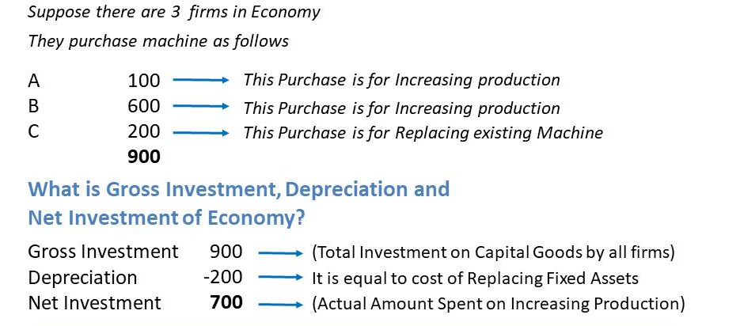
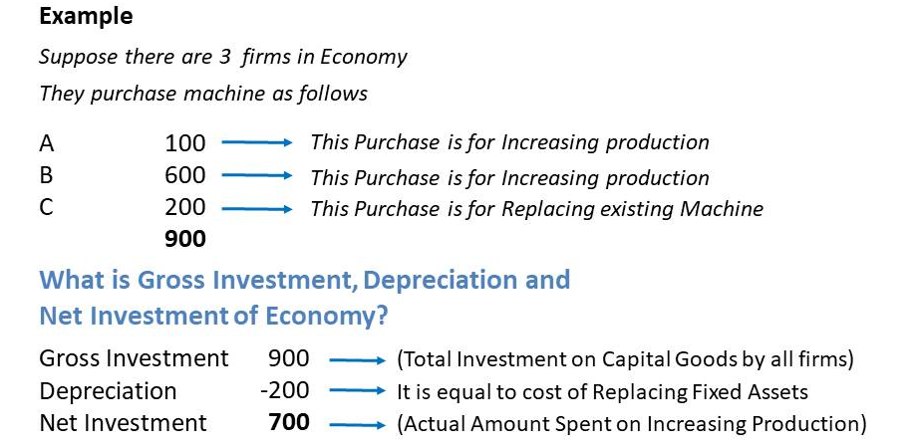
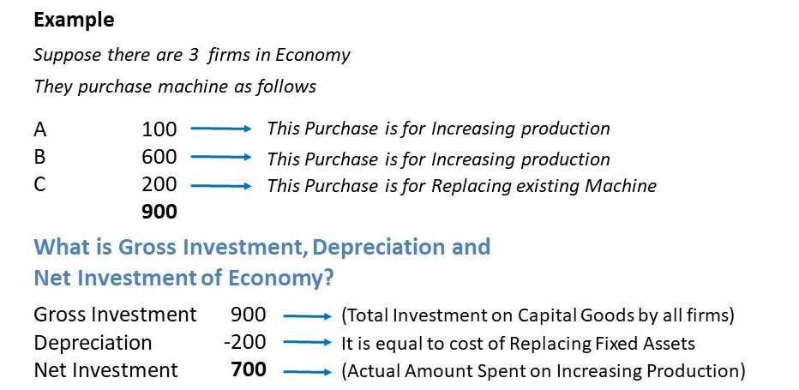
Gross investment vs Net investment

Slide 12
Review Question
Question: Suppose a small business owner decides to purchase a new piece of machinery for their manufacturing operation. The cost of the new machinery is ₹50,000. Additionally, during the same period, the business owner sells an old piece of machinery for ₹10,000.

Slide 13
Answer
Gross Investment:
Gross investment represents the total expenditure on new capital goods within a given period, regardless of any disposals of existing assets.
In this example, the gross investment is the cost of the new machinery, which is ₹50,000.
Gross Investment = Cost of New Machinery = ₹50,000
Net Investment:
Net investment represents the change in the stock of capital over a specific period after accounting for any disposals of existing assets.
It is calculated by subtracting the depreciation (or the value of disposed assets) from gross investment.
In this example, the value of disposed assets is the proceeds from selling the old machinery, which is ₹10,000.
Net Investment = Gross Investment - Depreciation = ₹50,000 - ₹10,000 = ₹40,000

Slide 14
Net Indirect Tax
It refers to the difference between indirect taxes and subsidies.
Indirect taxes are the taxes imposed on the production and sle of goods and services by the government.
Subsidies re the economic assistance given to the firm and household by the government with the aim of the general welfare. It is also known as financial assistance
Notes:
Net Indirect Tax (NIT) refers to the difference between indirect taxes and subsidies. Indirect Taxes are the taxes imposed on the production and sale of goods and services by the Government of a country, for example, GST (Goods and Services Tax). An indirect tax imposed on a good or service results in an increase in its price in the market. For example, if the cost of production of a good is ₹1,000 and the government levies 10% GST on it, then the good will be sold as ₹1,100 in the market. However, Subsidies are the economic assistance given to firms and households by the government with the aim of the general welfare. It is also known as financial assistance. For example, LPG cylinder in India is sold at a less rate or subsidized rate. The government usually grants subsidies to promote exports or to encourage organisations to set up industries in backward regions. Subsidies are not like indirect taxes, they reduce the market price of a good or service. For example, if the Government grants a ₹20 subsidy on the above-mentioned good, then it will be sold at ₹1,080 in the market.
Net Indirect Tax = Indirect Taxes – Subsidies

Slide 15
Factor Cost and Market Price
Factor cost is the amount paid to the factors of production for the factor services provided by them in the production process.
Market Price = Factor Cost + Net Indirect Taxes
Market Price is the price at which the product is actually sold in the market to the consumers.
Notes:
Factor cost is the amount paid to the factors of production for the factor services provided by them in the production process. In the above-given example, ₹1,000 is the Factor Cost. However, Market Price is the price at which the product is actually sold in the market to the consumers. The Market Price of a good or service includes indirect taxes and excludes subsidies. In the given example, the Market Price of the good is ₹1,080.
Market Price = Factor Cost + Net Indirect Taxes
Net Indirect is an important concept to differentiate between Factor Cost and Market Price of a good or service. The Market Price of a good or service includes Net Indirect Taxes; however, the Factor Cost of a good excludes NIT. Another important fact about indirect taxes and subsidies is that they only arise in the three-sector economy and four-sector economy, and not in the two-sector economy (households and firms).

Slide 16
Review Question
Question: The government imposes a 10% sales tax on all goods and services. Additionally, it provides a subsidy of 5% on certain essential goods. Calculate the net indirect tax revenue collected by the government if total sales tax revenue amounts to rupees 100 cr. and the subsidy expenditure on essential goods totals rupees 50 cr.
Notes:
Answer: rupees 50 cr

Slide 17
Resident of Country
Any individual or an institution who ordinarily resides in a country and whose center of economic interest lies in that country is the Normal Resident of that country.
The Centre of economic interest includes two things: First, the residents of a country lives or are located within the domestic territory. Second, from that location, these residents carry out basic economic activities of earnings, spending, and accumulation.
Notes:
Any individual or an institution who ordinarily resides in a country and whose center of economic interest lies in that country is the Normal Resident of that country. The Centre of economic interest includes two things: First, the residents of a country lives or are located within the domestic territory. Second, from that location, these residents carry out basic economic activities of earnings, spending, and accumulation.
However, the following are not included under Normal Residents:
1. Foreign tourists and visitors: All the foreign tourists and visitors who visit a country for vacation, medical treatment, study, sports, etc., are not considered normal residents of that country.
2. Foreign staff of embassies, diplomats, officials, and members of the armed forces: The foreign staff of diplomats, officials, embassies, and the members of armed forces of a foreign country residing/living in a given country are not considered as the normal residents of that country.
3. International Organisations: International organisations like IMF, WHO, etc., situated in a country are not considered as the normal residents of that country. Instead, they are included under normal residents of the international area.
4. Employees of International Organisations: Employees working in International Organisations like WHO, UNO, etc., are not considered normal residents of the international area. Instead, they are included under the normal residents of the country to which they belong. For example, a Japanese working at the WHO headquarters, Geneva will be treated as a normal resident of Japan. However, if the employee works for more than one year in such International Institutions, then he/she will become a normal resident of the country in which the institution is located. Therefore, in the given example, if the Japanese work for more than one year at WHO headquarters, he will become a normal resident of Switzerland.
5. Crew members of foreign vessels, commercial travellers and seasonal workers: All the crew members of foreign vessels, commercial travellers, and seasonal workers are not considered normal residents of the country, provided they stay for less than one year.
6. Border workers: Border workers living near the international borders of a country who cross the border regularly to work in another country, are treated as the normal resident of the country in which they live, not of the country in which they work.

Slide 18
Review Question
Which of the following is included under Normal Residents of India?
1. USA ambassador in India
2. Indian students going to study in Canada.
3. Americans coming to India for watching a cricket match.
4. American tourists staying in India for a month.
5. Indian employees working in WHO, located in India.
Notes:
Normal Residents of India typically refer to individuals who reside in India for a significant portion of the year or have their primary economic interests in India. Based on this definition, here's how each scenario would fit:
USA ambassador in India: No, the USA ambassador in India would not be considered a normal resident of India as they are a representative of the United States and likely have diplomatic status rather than residing in India as a regular resident.
Indian students going to study in Canada: Yes, Indian students going to study in Canada are still considered normal residents of India as their absence is temporary and they maintain their primary ties and interests in India.
Americans coming to India for watching a cricket match: No, Americans coming to India for watching a cricket match are considered visitors or tourists, not normal residents of India.
American tourists staying in India for a month: No, American tourists staying in India for a month are visitors, not normal residents of India.
Indian employees working in WHO, located in India: Yes, Indian employees working in WHO, located in India, are considered normal residents of India as they reside and work in India, despite working for an international organization.
So, the options that fit the definition of Normal Residents of India are 2. Indian students going to study in Canada and 5. Indian employees working in WHO, located in India.

Slide 19
Net Factor Income from Abroad (NFIA)
It is the difference between the factor income earned by a country from abroad/ rest of the world and factor income paid by a county abroad/ rest of the world
“Factor income from abroad” is the income earned by the normal residents of a country from the rest of the world in the form of wages, salaries, dividends, interest and rent.
“Factor income to abroad” is the factor income paid to the normal residents of other countries (i.e. non-residents) for their factor services within the economic territory
Notes:
It is the difference between the factor income earned by a country from abroad/rest of the world and factor income paid by a country abroad/rest of the world. Factor income from abroad is the income earned by a country’s normal residents from the rest of the world for the factor services provided by them. The income is earned in the form of rent, wages, interest, salaries, dividends and retained earnings. However, Factor income to abroad is the income paid by a country’s normal residents to the normal residents of other countries (i.e., non-residents of the former country) for the factor services given by them within the economic territory.
Net Factor Income from Abroad = Factor income earned from abroad – Factor income paid abroad
Significance of Net Factor Income from Abroad (NFIA)
Net Factor from Abroad (NFIA) is essential for differentiating between the Domestic Income and National Income of an economy. At first, the Domestic Income is determined, and then after adding NFIA to it, National Income is determined.
The difference between factor income from abroad and factor income to abroad is NFIA or Net Factor Income from Abroad. Therefore, another formula for National Income is,
National Income = Domestic Income + NFIA
The Net Factor Income from Abroad of an economy can be zero, positive, or negative.
It will be zero when the factor income earned from abroad and paid to abroad is equal.
NFIA will be positive when the factor income earned from abroad is more than the factor income paid to abroad.
However, it will be negative when the factor income earned from abroad is less than the factor income paid to abroad.

Slide 20
Review Question
Question: Calculate NFIA if factor income from abroad is rupees 670 and factor income to abroad is rupees 1500
Ans. –(850)
Question: Calculate Factor income from abroad if NFIA is rupees 800 and factor income to abroad is rupees is rupees 500
Ans. Rupees 1300

Slide 21
Domestic (Economic Territory)
In national income accounting, domestic territory refers to the geographic area within a country's borders where economic activities take place and are measured for the purpose of calculating national income and other macroeconomic indicators.
Domestic Territory or Economic Territory is an essential concept of national income accounting, which simply means the political frontiers of a country.
Notes:
Domestic Territory or Economic Territory is an essential concept of national income accounting, which simply means the political frontiers of a country. However, the term Domestic Territory is used in a wider sense when it comes to national income accounting.
Along with Political Frontiers, Domestic Territory also consists of the following items:
1. Embassies, military establishments, and consulates of a country located abroad. Any embassy, military establishment, and consulate of a country that has an office or branch abroad are also included under the domestic territory of a country. Here, a consulate is a building or an office used by an officer. also known as consul, commissioned by the government of a country to reside in a foreign country for the promotion of the interest of the country to which he/she belongs. For example, Indian Embassy in the USA is a part of the domestic territory of India.
2. Ships and aircraft owned and operated by normal residents between two or more countries. If a normal resident of a country owns and operates ships and aircraft between two or more countries, then those ships and aircraft will be included in the domestic territory of the country. For example, airplanes operated by Air India between Japan and Russia are a part of the domestic territory of India.
3. Fishing vessels, oil and natural gas rigs and floating platforms operated by the residents of a country in the international waters where they have exclusive rights of operation. If a resident of a country operates fishing vessels, oil and natural gas rigs, and floating platforms in the international waters, it will be included in the domestic territory of that country. However, the resident must have rights of operation in the international waters. For example, if an Indian Fisherman operates a fishing boat in the international waters of the Pacific Ocean, it will be considered a part of the domestic territory of India.
However, the following are not included in the Domestic Territory of a country:
1. Embassies, military establishments, and consulates of a foreign country are not included in the domestic territory of a country. For example, USA Embassy in India is not a part of the domestic territory of India, instead, it will be a part of the domestic territory of the USA.
2. Any International organisation such as WHO, UNO, etc., located within the geographical boundaries of a country will not be a part of the domestic territory of that country.

Slide 22
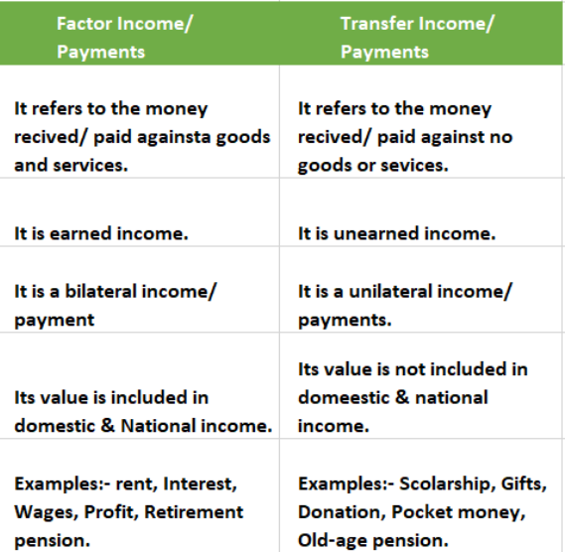
Notes:
Factor payments and transfer payments are two different types of payments in an economy, and they serve different purposes. Let's define each:
Factor Payments:
Factor payments are payments made to factors of production for their contribution to the production process. Factors of production include labor (wages), capital (interest), land (rent), and entrepreneurship (profits). These payments are made in exchange for the productive services provided by these factors in the production of goods and services. Factor payments are directly related to the production process and contribute to the generation of national income.
Transfer Payments:
Transfer payments are payments made by the government to individuals, households, or other levels of government without any corresponding contribution to the production process.They are typically made for social welfare purposes, income redistribution, or to fulfill certain social or economic objectives. Examples of transfer payments include social security benefits, unemployment benefits, welfare payments, pensions, and subsidies. Transfer payments do not result from the production of goods and services but rather involve the redistribution of income or wealth within the economy.
Why transfer payments are not included in the calculation of national income:
No Corresponding Production:
Transfer payments do not represent payments for productive services rendered in the production process. Instead, they involve the redistribution of income from one group to another without any corresponding contribution to the economy's output of goods and services.
Avoiding Double Counting:
Including transfer payments in the calculation of national income would lead to double counting because these payments are already reflected in the factor incomes of recipients.
Accuracy of Economic Indicators:
Excluding transfer payments from the calculation of national income helps provide a more accurate measure of the economy's productive activity and performance.
In summary, while factor payments are included in the calculation of national income as they represent payments for productive services, transfer payments are excluded because they involve income redistribution without corresponding production and including them would lead to inaccuracies and double counting in economic indicators.

Slide 23
Review Question
Which of the following is a part of the domestic territory of India?
1. Indian Embassy in Pakistan.
2. An Indian organization in Japan.
3. Office of HUL in Africa.
4. A company owned by an American in India.
5. USA Embassy in India.
Notes:
1. Yes, it is a part of the domestic territory of India.
2. No, it is not a part of the domestic territory of India.
3. No, it is not a part of the domestic territory of India.
4. Yes, it is a part of the domestic territory of India.
5. No, it is not a part of the domestic territory of India.

Slide 24
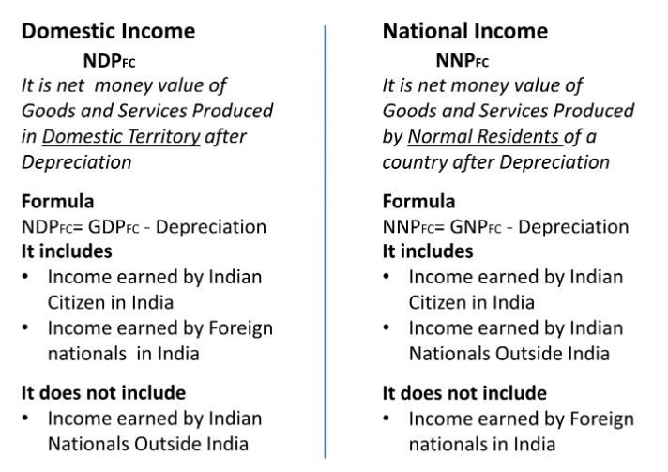
Domestic Income vs National Income
Notes:
Domestic Income: (NDP at factor cost)
Domestic income refers to the total income earned by all factors of production (such as labor, capital, and land) located within a country's borders, regardless of the nationality of the owners. It includes all income generated from the production of goods and services within the country, including wages, profits, rents, and interest. Domestic income focuses on the income generated from domestic economic activities, regardless of whether the income accrues to domestic residents or foreigners. It does not account for income earned by residents from economic activities conducted abroad or income earned by foreign residents from economic activities within the country.
National Income: (NNP factor cost)
National income, on the other hand, refers to the total income earned by all factors of production owned by residents of a country, regardless of where the production takes place. It includes all income earned by residents from domestic economic activities as well as income earned from economic activities conducted abroad. National income accounts for the income earned by residents from factors of production located both within and outside the country's borders. It excludes income earned by foreigners from economic activities within the country's borders.
In summary, while domestic income focuses on income generated from economic activities within a country's borders, national income accounts for income earned by residents from both domestic and foreign economic activities. National income provides a more comprehensive measure of the total income earned by the residents of a country, taking into account both domestic and international economic transactions.

Slide 25
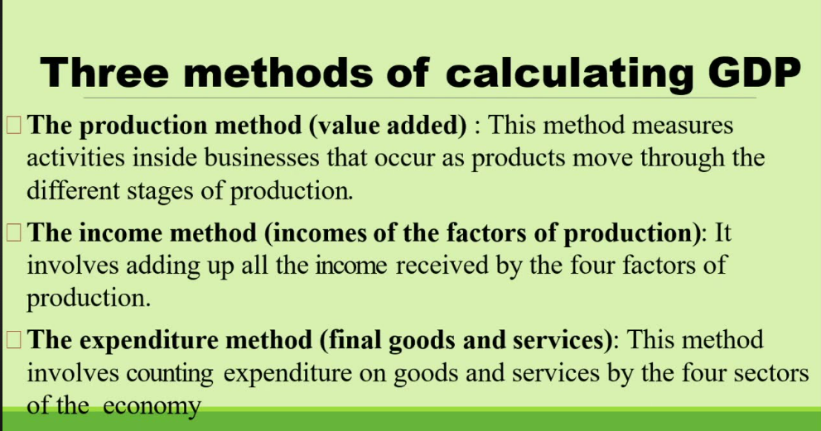
Measurement of GDP
Notes:
Gross Domestic Product (GDP) is a key indicator used to measure the size and performance of an economy. There are three primary methods used to calculate GDP: the expenditure approach, the income approach, and the production (or output) approach. Let's delve into each method:
Expenditure Approach:
The expenditure approach calculates GDP by summing up all the spending on final goods and services within the economy.
It breaks down GDP into four main components: a. Consumption (C): Spending by households on goods and services. b. Investment (I): Spending by businesses on capital goods (such as machinery and equipment), residential construction, and changes in business inventories. c. Government spending (G): Spending by the government on goods and services, excluding transfer payments. d. Net exports (NX): Exports (goods and services sold to foreign countries) minus imports (goods and services purchased from foreign countries).
The formula for GDP using the expenditure approach is: GDP = C + I + G + NX.
Income Approach:
The income approach calculates GDP by summing up all the incomes earned within the economy.
It includes various forms of income earned by individuals and businesses, such as wages and salaries, interest, rent, and profits.
The formula for GDP using the income approach is: GDP = Compensation of Employees + Gross Operating Surplus + Gross Mixed Income + Taxes on Production and Imports - Subsidies on Production and Imports.
Production (Output) Approach:
The production approach calculates GDP by summing up the value added at each stage of production within the economy.
Value added is the difference between the value of a firm's output and the value of the intermediate inputs it purchases from other firms.
This method focuses on the value added by each sector of the economy (such as agriculture, manufacturing, and services) and aggregates them to arrive at total GDP.
The formula for GDP using the production approach is: GDP = Value Added in Agriculture + Value Added in Manufacturing + Value Added in Services + ...

Slide 26
Review Question
Question: Which of the following organization calculates Gross Domestic Product (GDP) in India?
National Statistical Office (NSO)
Ministry of Commerce and Industry
Indian Statistical Institute
Reserve Bank of India
Answer: National Statistical Office

Slide 27
Review Question
Question : Which of the following is not a method to calculate the Gross Domestic Product
(a) Product method
(b) Income law
(c) Expenditure method
(d) Diminishing cost method
Answer: Diminishing cost method

Slide 28
Review Question
Question: Firm A buys from K firm inputs worth ₹600 Crores and sells to firm B goods worth ₹1,500 Crores and to firm C worth ₹760 Crores. Firm B buys from L inputs worth ₹300 Crores and sells to firm C goods worth ₹1,200 Crores and finished goods worth ₹2,500 to the households. Firm C buys from M inputs worth ₹100 Crores and sells finished goods worth ₹3,250 to the households. Calculate Value Added by firms A, B, and C. Also calculate Gross Domestic Product at Market Price.
Notes:
Value Added by Firm A = GVA_{MP} of A = ₹1,660 Crores
Value Added by Firm B = GVA_{MP} of B = ₹1,900 Crores
Value Added by Firm C = GVA_{MP} of C = ₹1,190 Crores
GDP_{MP} = ∑GVA_{MP}
GDP_{MP} = 1,660 + 1,900 + 1,190
GDP_{MP} = ₹4,750 Crores

Slide 29
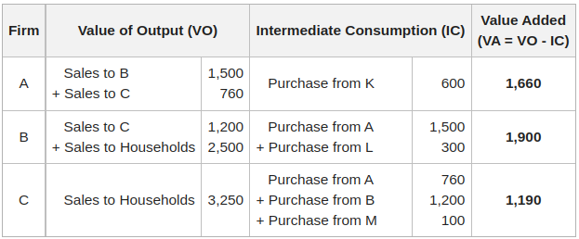
Answer
Notes:
Value Added by Firm A = GVA_{MP} of A = ₹1,660 Crores
Value Added by Firm B = GVA_{MP} of B = ₹1,900 Crores
Value Added by Firm C = GVA_{MP} of C = ₹1,190 Crores
GDP_{MP} = ∑GVA_{MP}
GDP_{MP} = 1,660 + 1,900 + 1,190
GDP_{MP} = ₹4,750 Crores

Slide 30
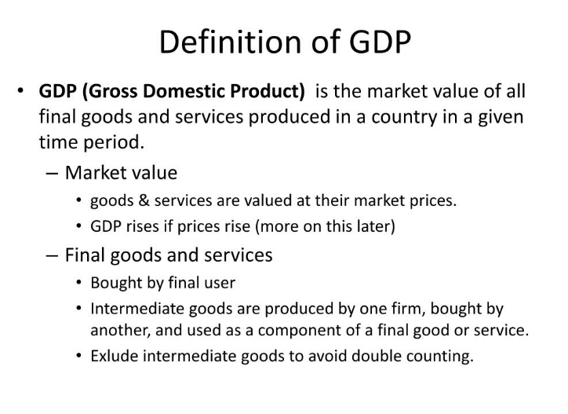

Slide 31
Review Question
Question: How frequently is GDP calculated in India?
Annually
Quarterly and Annually
Half-yearly and Annually
Monthly
Answer: b
Notes:
GDP (Gross Domestic Product) is calculated by different countries at different intervals of time. In India, GDP is calculated quarterly and annually. The annual measure of GDP encompasses a financial year. In India, the financial year starts from 1 April of a year and ends on 31 March of the next year.

Slide 32
Review Question
Question: The value of which work is added in the calculation of GDP?
(a) Housewives' works
(b) A teacher teaching his own child
(c) The value of resale of old shares
(d) Construction of new house by an artisan
Answer: d
Notes:
The value of the construction of a new house is added in the calculation of the GDP because it is a new production work in the economy for which payment is being done.

Slide 33
Is GDP an indicator of welfare?
GDP is an indicator of welfare but not an adequate indicator.
Reasons:
Distribution of GDP
Non-Monetary Exchanges
Changes in Prices
Externalities
Rate of Population Growth
Notes:
While GDP (Gross Domestic Product) is a widely used measure of economic activity and is often correlated with overall welfare and standard of living, it does have limitations as an indicator of welfare. Here are some reasons why GDP may not be considered an adequate indicator:
Distribution of GDP: GDP does not reflect how income and wealth are distributed among the population. Even if GDP grows, it does not necessarily mean that all segments of society benefit equally. Rising GDP may lead to widening income inequality if the benefits disproportionately accrue to a small portion of the population.
Non-Monetary Exchanges: GDP primarily measures market-based economic transactions and does not account for non-market activities such as household production, volunteer work, and informal sector transactions. These non-monetary exchanges contribute to welfare but are not reflected in GDP figures.
Changes in Prices: GDP does not adjust for changes in the price level, meaning that an increase in GDP may be partly due to inflation rather than real growth in economic output. Similarly, a decrease in GDP during periods of deflation may not necessarily indicate a decline in welfare.
Externalities: GDP does not account for the environmental and social costs associated with economic activities, such as pollution, depletion of natural resources, and negative health effects. These externalities can have significant welfare implications but are not captured by GDP.
Rate of Population Growth: GDP per capita, which divides total GDP by the population, is often used as a proxy for standard of living. However, changes in GDP per capita may be influenced by population growth rather than improvements in individual welfare. High population growth rates can dilute the benefits of economic growth and lead to lower welfare per capita.
In summary, while GDP provides valuable information about the size and growth of the economy, it has limitations as a measure of welfare. To obtain a more comprehensive understanding of overall well-being, policymakers and researchers often supplement GDP with other indicators that capture aspects such as income distribution, non-market activities, quality of life, environmental sustainability, and social progress.

Slide 34
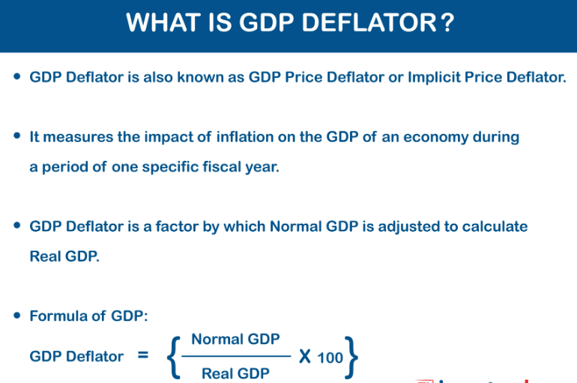
Notes:
GDP deflator, also known as the implicit price deflator, is used to measure inflation. It is used to determine the levels of prices of the new domestically produced final goods and services in a country in a year. It shows the changes in the average price levels in an economy, and therefore, it is used in conjunction with the Consumer Price Index (CPI) for measuring inflation.
GDP deflator consists of two important components, which are the nominal GDP and real GDP.
Nominal GDP is the monetary value of all the goods and services produced in an economy and is valued at current prices, while the real GDP shows the monetary value of all the finished goods and services in an economy calculated at constant prices.
For calculating GDP deflator, the following steps are necessary.
Determine the nominal GDP.
Determine the real GDP.
Find the GDP Deflator.
GDP deflator formula can be represented as:
GDP deflator = Nominal GDP/Real GDP * 100
A GDP deflator of 100 implies that nominal GDP equals real GDP, meaning there is no inflation or deflation. A GDP deflator greater than 100 indicates inflation, while a GDP deflator less than 100 indicates deflation when compared to the price level of the base year.
Changes in the GDP deflator affect the purchasing power of money. If the GDP deflator increases, the purchasing power of money decreases because it takes more money to buy the same basket of goods and services.
Conversely, if the GDP deflator decreases, the purchasing power of money increases because it takes less money to buy the same basket of goods and services.

Slide 35
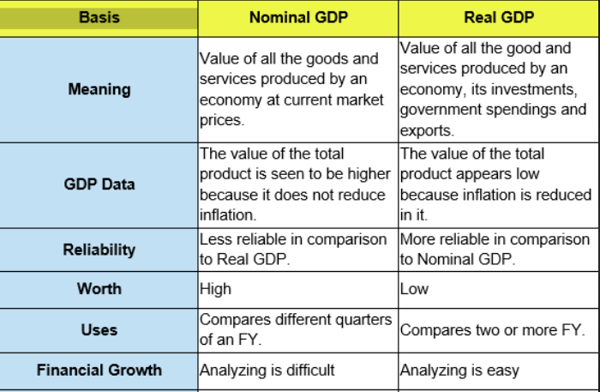
Nominal GDP vs Real GDP
Notes:
GDP or Gross Domestic Product is the total money value of all the goods and services manufactured within the geographical boundaries of a country during a period of one year. Gross in GDP means that depreciation is included in the monetary value of the goods and services. Domestic signifies that goods and services included in GDP are produced within the domestic boundaries of the country. However, product means that only final goods and services will be included.
Nominal GDP or GDP at Current Price
Nominal GDP is the Gross Domestic Product of a country of a given year, estimated on the basis of the price of the goods and services of the same year. Example: Suppose in a hypothetical economy, the price of one unit of a particular good is ₹10 and 100 units are produced/sold. The nominal GDP contribution of this good would be ₹10 * 100 = ₹1,000. Similarly, if there are other goods and services produced and sold in the economy, their respective nominal GDP contributions would be calculated based on their prices and quantities.
Real GDP or GDP at Constant Price
Real GDP is the Gross Domestic Product of a country of a given year, estimated on the basis of the price of the goods and services of a base year. Continuing from the previous example, suppose the base year prices for the same good were ₹8 per unit. Using the base year prices, the real GDP contribution of this good would be ₹8 * 100 = ₹800. Similarly, the real GDP contributions of other goods and services would be calculated using their respective base year prices.
In summary, nominal GDP measures economic output using current market prices, while real GDP adjusts for changes in price levels to provide a more accurate measure of economic output over time. Real GDP is often preferred for comparing economic performance across different time periods or countries as it accounts for the impact of inflation or deflation.
The Real GDP of a country can be more, equal, and less than its Nominal GDP.
Real GDP > Nominal GDP: When the price level of goods and services in the base year is more than the price level of goods and services in the current year.
Real GDP = Nominal GDP: When the price level of goods and services in the base year is the same as the price level of goods and services in the current year.
Real GDP < Nominal GDP: When the price level of goods and services in the base year is less than the price level of goods and services in the current year.
Is Nominal GDP better or Real GDP?
Real GDP is better than Nominal GDP because of the following reasons:
1. Helps in the determination of the effect of increased production
Real GDP helps an economy to determine the effect of increased production levels of goods and services within a year. Real GDP is better for this determination because even though there is no change in the physical or actual production of goods and services, a change in their price affects the value of Nominal GDP.
2. Better Periodic Comparison
Real GDP is better than Nominal GDP for making a periodic comparison in the production of physical output of goods and services of a country over different years.
3. Facilitates International Comparison
The Real GDP of an economy also facilitates a better international comparison of the economic performance across the countries.

Slide 36
Review Question
Question: Which statement is correct for nominal GDP?
Nominal GDP is calculated based on current prices.
Nominal GDP is calculated based on the base prices.
Data on Nominal GDP shows an accurate picture of the economy as compared to real GDP.
(a) Only ii, iii
(b) only ii
(c) only i
(d) i, iii
Answer: c

Slide 37
Review Question
Calculate the GDP Deflator of an economy if its Nominal and Real GDP are ₹15,000 and ₹10,000, respectively.
Notes:
Answer: 150

Slide 38
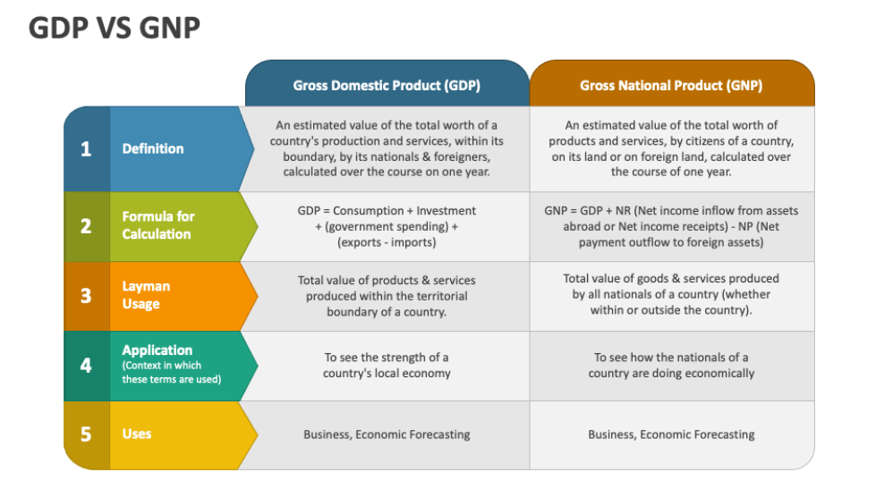
Notes:
Gross Domestic Product (GDP) and Gross National Product (GNP) are both important measures used to assess the size and performance of an economy, but they focus on different aspects of economic activity and ownership. Here's an explanation of what information GDP provides and how it differs from GNP:
Gross Domestic Product (GDP):
GDP measures the total value of all goods and services produced within the geographical boundaries of a country during a specific period, regardless of the ownership of the factors of production. It provides valuable information about the level of economic activity, output, and income generated within a country's borders. GDP includes the value of goods and services produced by both domestic and foreign factors of production (labor and capital) located within the country. GDP is typically used to assess the overall size and growth rate of an economy, as well as to compare economic performance across different countries.
Gross National Product (GNP):
GNP measures the total value of all goods and services produced by the factors of production owned by the residents (citizens and businesses) of a country, regardless of where those factors are located geographically. It provides information about the total income earned by a country's residents, including income generated from domestic and foreign sources. GNP includes the value of goods and services produced domestically as well as any income earned by domestic factors of production (such as profits and dividends) from investments abroad, minus any income earned by foreign factors of production within the country. GNP is used to assess the economic well-being of a country's residents and their ability to generate income from both domestic and international sources.
In summary, GDP provides information about the total value of goods and services produced within a country's borders, regardless of the ownership of the factors of production, while GNP provides information about the total income earned by a country's residents, regardless of where that income is generated. The main difference between GDP and GNP lies in their focus on economic activity within the country's borders (GDP) versus the ownership of factors of production by residents (GNP).

Slide 39
Review Question
Net National Product at Factor cost = 5000
Depreciation = 500
Subsidies = 100
Indirect Tax = 200
Factor income from abroad = 200
Factor income to abroad = 100
Calculate GDP at market price.
Notes:
Answer: 5500

Slide 40
Review Question
GNP at market price = 10,000
Depreciation = 1000
Net Factor income from abroad = 500
Net Indirect Tax = 2000
Calculate NDP at Factor Cost
Notes:
Ans. 6500

Slide 41
Determination of Income and Employment
Aggregate Demand
Aggregate demand refers to the total quantity of goods and services demanded in an economy at a given overall price level and in a given time period.
It encompasses the total demand for all goods and services within an economy, including consumption, investment, government spending, and net exports.
Aggregate demand is influenced by factors such as changes in consumption patterns, investment levels, government policies (such as fiscal and monetary policies), and global economic conditions.

Slide 42
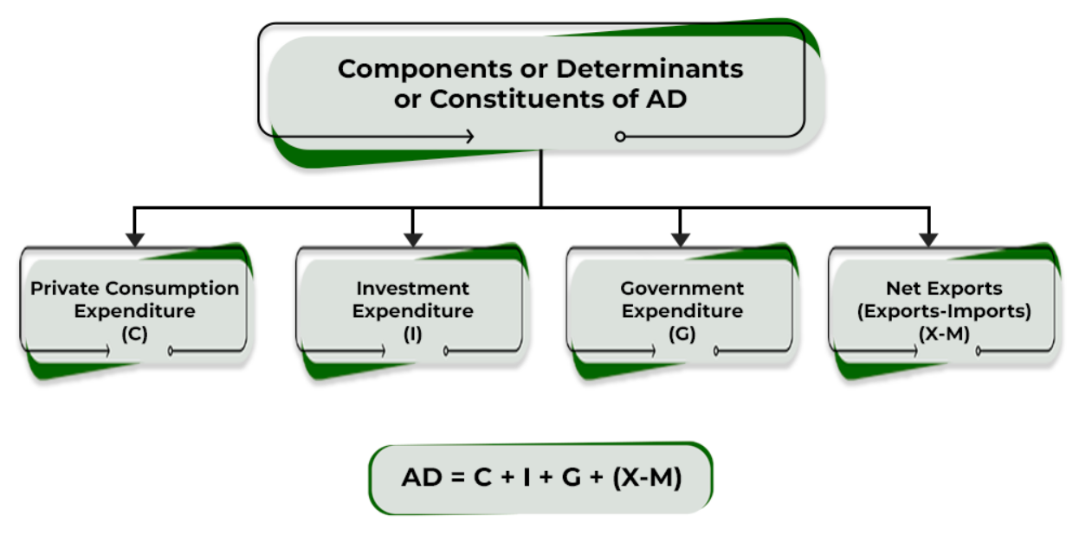
Components of Aggregate Demand

Slide 43
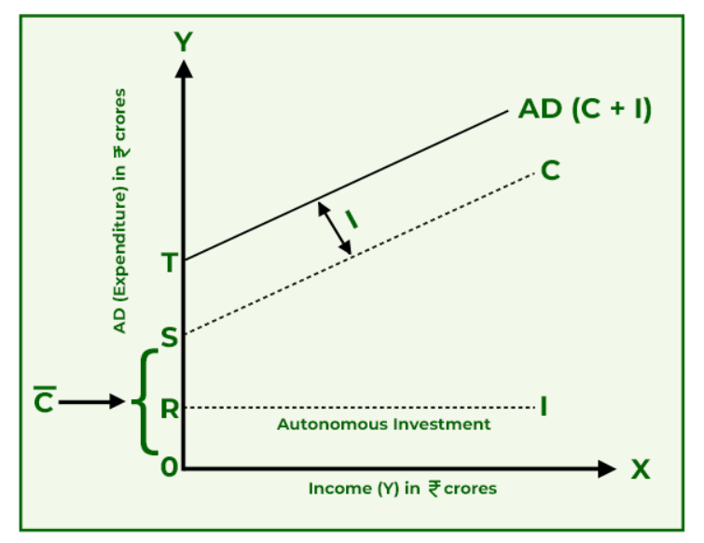
Aggregate Demand

Slide 44
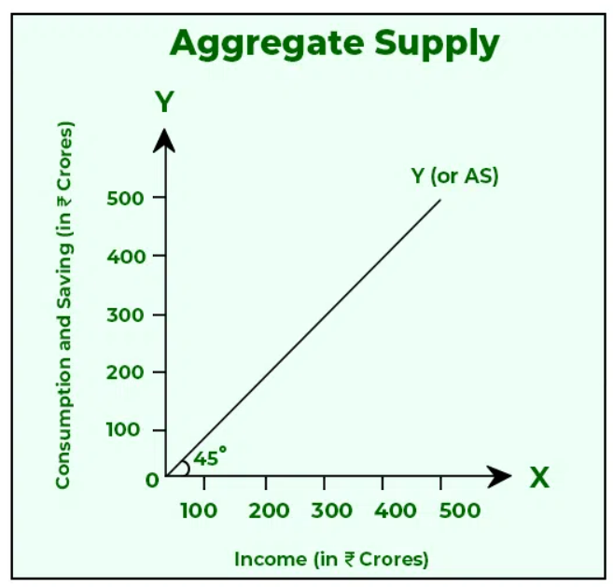
Aggregate Supply Curve
Aggregate supply refers to the total quantity of goods and services that all producers in an economy are willing and able to supply at different price levels over a specific period, holding all other factors constant. It represents the total output of goods and services produced by businesses within an economy.

Slide 45
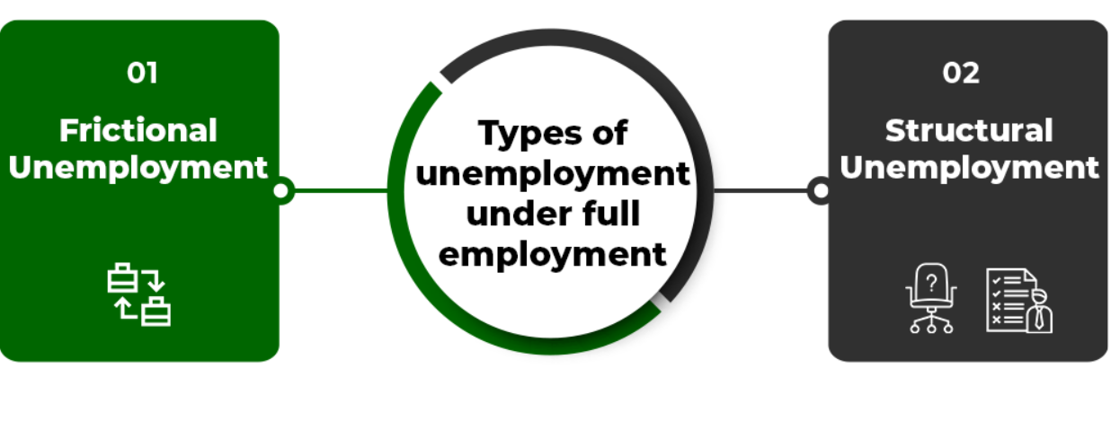
Full Employment
It is a situation in which all of those people who are willing and able to work at an existing wage rate without any undue difficulty, get work. In general, the term Full Employment means that there is no unemployment in an economy; i.e., everyone gets a job.
Notes:
In simple terms, full employment means that the demand for labour in the economy is equal to its supply. But, in macroeconomics, even during full employment some types of unemployment can exist. It means that full employment does not result in zero unemployment or cent per cent employment.
The two types of unemployment that can exist under full employment are as follows:
1. Frictional Unemployment:
Frictional unemployment means temporary unemployment, which exists during the time period when a worker leaves one job and joins another job. Such type of unemployment arises because of the labour market imperfections like lack of perfect mobility from the side of workers and lack of market information among the workers regarding job availability. Besides these, frictional unemployment may exist because of the introduction of new machines, breakdown of plant, or nationalisation in the production process.
2. Structural Unemployment:
Structural Unemployment is the type of unemployment in which people remain unemployed because of a mismatch between the unemployed people and the demand for workers of a particular type. In simple terms, structural unemployment is associated with the structural changes in an economy. For example, because of advancements in technology, workers who do not have enough knowledge to work on advanced technological machines or equipment will be unemployed until they take some training course.
The presence of Frictional Unemployment and Structural Unemployment in an economy is termed the Natural rate of Unemployment.
Note: The workers mentioned in full employment consist only labour force, i.e., the working population and not the total population. The labour force is that part of the population which mentally and physically able and willing to do work and does not consist of children and old persons.
Involuntary Unemployment
It is a type of unemployment in which all those people who are willing and able to get work at an existing wage rate, do not get work. In simple terms, under involuntary unemployment, people are unemployed against their wishes or under some compulsion. Besides, while determining the total unemployment of an economy, only involuntary unemployment is considered.
Voluntary Unemployment
It is a type of unemployment in which even though a person is physically and mentally fit is unemployed because of his unwillingness to do work at an existing wage rate. While determining the total unemployment of an economy, voluntary unemployment is not considered.

Slide 46
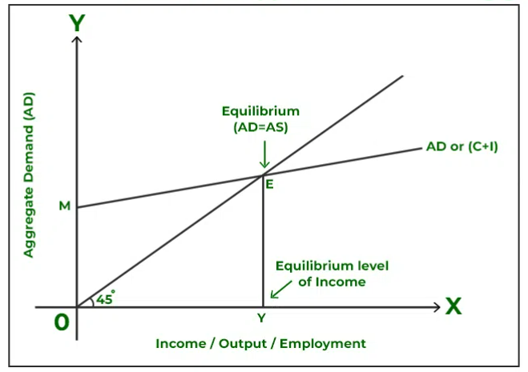
Determination of Equilibrium Income (AD-AS Approach)
Notes:
Aggregate demand (AD) is the total amount of final products and services that all sectors of the economy intend to purchase over a single accounting year at a specific level of income. Whereas, Aggregate Supply (AS) refers to the monetary value of finished goods and services that all producers are prepared to supply to an economy over a specific time frame. The Aggregate Demand-Aggregate Supply Approach (AD-AS Approach) is used to determine the equilibrium level of income, output, and employment in an economy.
Determination of Equilibrium Level
The Keynesian Theory states that the equilibrium situation is usually expressed in terms of Aggregate Demand (AD) and Aggregate Supply (AS). When aggregate demand for products and services over a given period of time equals aggregate supply, an economy is in equilibrium.
So, equilibrium is attained when:
AD = AS
Assumptions
The various assumptions used to determine equilibrium output are:
The determination of the equilibrium level will be examined using a two-sector model (households and firms). Simply put, it is assumed that there is no foreign industry or government in the economy.
It is also assumed that investment expenditure is autonomous, i.e., that income level does not have any impact on investments.
It is assumed that the pricing level is constant.
Also, to determine equilibrium output, short-run will be considered.
Aggregate Demand-Aggregate Supply Approach (AD-AS Approach)
The Keynesian theory states that when aggregate demand, as shown by the C+I curve is equal to the total output (Aggregate Supply or AS), the equilibrium level of income in an economy is established.
There are two parts to the aggregate demand:
Consumption Expenditure (C): This expenditure changes directly with income; i.e., consumption rises as income rises.
Investment Expenditure (I): This expenditure is considered to be autonomous and independent of one’s income level.
So, in the income determination analysis, the AD curve is represented by the C+I curve.
The overall output of goods and services from the national income is known as the aggregate supply. A 45° line is used to represent it. The AS curve is represented by the (C+S) curve because the money received is either spent or saved.
The AD or (C+ I) curve in the above graph shows the desired expenditure level by consumers and businesses at each level of income. At point E where the (C+ I) curve intersects the 45° line, the economy is in equilibrium.
Observations:
The equilibrium point, denoted by the letter E, occurs when desired expenditure on consumption and investment is equal to the total output.
OY is the output at the equilibrium level that corresponds to point E.
In the above table, the Aggregate Demand is equal to the Aggregate Supply; i.e., ₹200 Crores, when the equilibrium level of income is ₹200 Crores.
It is a case of Effective Demand. Effective demand refers to that level of AD that becomes ‘effective’ since it is equal to AS.
Readjustment Process
When there is any deviation from the equilibrium level of output; i.e., if the planned spending or AD is not equal to planned output or AS, then to bring them equal to each other, the process of readjustment is started in the economy.
1. When AD is more than AS
If planned expenditure (AD) exceed planned output (AS), the (C+ I) curve will be over the 45° line. In this situation, consumers and businesses together would be purchasing more items than they are willing to produce, because of which the planned inventory would ultimately fall below the desired level. Therefore, until the economy reaches output level OY, where AD equals AS and there is no longer a tendency to fluctuate, firms would increase employment and output to bring the inventory back to the desired level.
Planned Inventory refers to the unsold inventory that has been anticipated in the event of an expected decline in sales; whereas, Unplanned Inventory refers to the unanticipated change in stock as a result of an unexpected decline in sales.
2. When AD is less than AS
If planned expenditure (AD) is less than planned output (AS), (C+ I) curve will lie below the 45° line. In this situation, consumers and businesses together would be purchasing fewer items than they are willing to produce, because of which the planned inventory would rise. Therefore, until the economy reaches output level OY, where AD equals AS and there is no longer a tendency to fluctuate, firms would decrease employment and output to bring unwanted inventory back to the desired level.

Slide 47
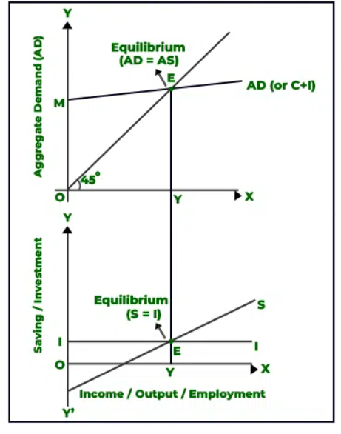
Determination of Equilibrium Income (S-I Approach)
The equilibrium point, denoted by the letter E, occurs where saving and investment curves intersect each other.
Also, at point E, ex-ante saving is equal to ex-ante investment.
The equilibrium level of output corresponding to the equilibrium point E is OY.
Notes:
The Investment curve in the above graph shows the autonomous investment made; therefore, it is parallel to the X-axis. The Saving Curve S slopes upward, which means that saving increases with an increase in income. At point E where the investment curve intersects the saving curve, the economy is in equilibrium.
Observations:
The equilibrium point, denoted by the letter E, occurs where saving and investment curves intersect each other.
Also, at point E, ex-ante saving is equal to ex-ante investment. (ex-ante means planned)
The equilibrium level of output corresponding to the equilibrium point E is OY.
In the above table, planned saving is equal to planned investment; i.e., ₹30 Crores, when the equilibrium level of income is ₹200 Crores.
Readjustment Process
When there is any deviation from the equilibrium level of income; i.e., if the planned saving or S is not equal to planned investment or I, then to bring them equal to each other, the process of readjustment is started in the economy.
1. When Saving is more than the Investment
In the above diagram, if planned saving (S) exceeds planned investment (I) (after point E), it implies that households are not consuming as much as the businesses expected, which results in an increase in the inventory level above the desired level. Therefore, to get rid of the unwanted increase in inventory, until saving and investment become equal to each other, companies would plan to reduce output.
2. When Saving is less than the Investment
In the above diagram, if planned saving (S) is less than planned investment (I) (before point E), it implies that consumers are likely consuming more and saving less than what businesses expect, which results in a reduction in the inventory level below the desired level. Therefore, in order to bring the inventory back to the desired level, until saving and investment become equal to each other, firms would plan to increase output.

Slide 48
Consumption Function
The consumption function can be expressed as follows:
C = a + bY
Where:
C represents consumption expenditure by households.
Y represents disposable income (income left after deducting taxes).
'a' represents autonomous consumption, which is the level of consumption that occurs even when disposable income is zero. It includes essential spending on necessities like food, rent, and basic utilities.
'b' represents the marginal propensity to consume (MPC), which is the proportion of additional income that households choose to spend on consumption.
Notes:
The consumption function is a fundamental concept in economics, particularly in Keynesian economics, that describes the relationship between consumption and disposable income in an economy. It shows how changes in disposable income influence changes in consumption expenditure by households.
Key points about the consumption function:
Autonomous consumption ('a'): Even when households have no disposable income, they still have to spend on essential goods and services. This represents autonomous consumption, which is typically positive and reflects the minimum level of consumption necessary for survival.
Marginal propensity to consume (MPC) ('b'): The MPC measures the change in consumption resulting from a change in disposable income. It is the slope of the consumption function and represents the fraction of additional income that households choose to spend rather than save. The MPC is usually less than one, indicating that households tend to save a portion of their additional income.
Relationship between consumption and income: According to the consumption function, consumption expenditure increases as disposable income increases, but not by the full amount of the increase in income. Instead, households typically consume a fraction of their additional income, as determined by the MPC.
Aggregate demand: The consumption function is essential for understanding aggregate demand in an economy. Since consumption is a significant component of aggregate demand, changes in consumption expenditure have a significant impact on overall economic activity and output.
Overall, the consumption function provides insights into how changes in disposable income affect household consumption decisions and, consequently, overall economic performance.

Slide 49
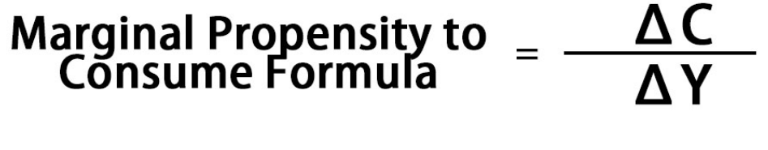
Marginal Propensity to Consume (MPC)
It is the ratio of the change in consumption expenditure to the change in total income. In simple terms, MPC explains the proportion of change income that is spent on consumption. The formula to determine Marginal Propensity to Consume (MPC) is as follows:
Notes:
The marginal propensity to consume (MPC) is a concept in economics that refers to the proportion of an additional unit of income that a consumer spends on consumption. In other words, it measures the change in consumption in response to a change in income.
Mathematically, the marginal propensity to consume can be expressed as the change in consumption (ΔC) divided by the change in income (ΔY):
MPC = ΔC / ΔY
For example, if an individual receives an additional ₹100 in income and spends ₹80 of it on consumption goods and saves ₹20, the marginal propensity to consume would be 0.80 (₹80/₹100). This means that for every additional rupee of income, the individual spends 80% of it on consumption.
The marginal propensity to consume is an important concept in Keynesian economics and helps to explain how changes in income affect overall consumption patterns and aggregate demand in the economy. It is also used to analyze the effectiveness of fiscal and monetary policies in stimulating economic activity.

Slide 50
Saving Function
The saving function can be expressed as follows:
S = -a + (1 - b)Y
Where:
S represents saving by households.
Y represents disposable income.
'a' represents autonomous saving, which is the level of saving that occurs even when disposable income is zero. It includes saving for future needs, such as retirement or emergencies.
'b' represents the marginal propensity to consume (MPC), which is the proportion of additional income that households choose to spend on consumption. Since saving is the portion of income not spent on consumption, (1 - b) represents the fraction of additional income that households choose to save.
Notes:
The saving function, like the consumption function, is a key concept in economics that describes the relationship between saving and disposable income in an economy. It shows how changes in disposable income influence changes in saving behavior by households.
Key points about the saving function:
Autonomous saving ('a'): Similar to autonomous consumption, autonomous saving represents the level of saving that occurs regardless of disposable income. It reflects the tendency of households to save a certain amount of their income, even when they have no disposable income.
Marginal propensity to consume (MPC) ('b'): Since saving is the portion of income not spent on consumption, the marginal propensity to consume is used to determine the portion of income that households choose to save. The parameter (1 - b) represents the fraction of additional income that households choose to save rather than spend on consumption.
Relationship between saving and income: According to the saving function, saving increases as disposable income increases, but not by the full amount of the increase in income. Instead, households typically save a fraction of their additional income, as determined by the marginal propensity to consume.
Factors influencing saving behavior: The saving function helps to understand how changes in disposable income, interest rates, consumer confidence, and other factors influence household saving decisions. Changes in these factors can affect both autonomous saving and the marginal propensity to save, leading to changes in overall saving behavior.
Overall, the saving function provides insights into how changes in disposable income and other factors influence household saving decisions and, consequently, overall economic performance.

Slide 51
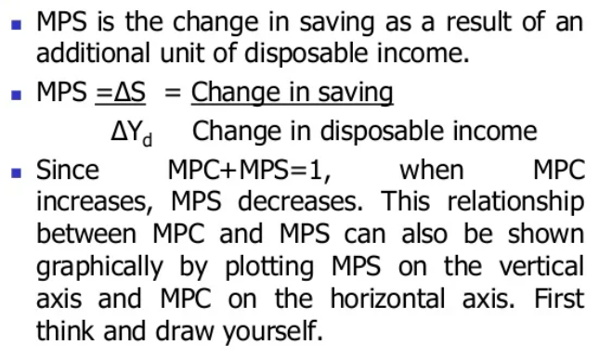
Marginal Propensity to Save (MPS)
Notes:
The marginal propensity to save (MPS) is a concept in economics that represents the proportion of an additional unit of income that households choose to save rather than consume. It measures the change in saving resulting from a change in disposable income.
Mathematically, the marginal propensity to save can be expressed as the change in saving (ΔS) divided by the change in income (ΔY):
MPS = ΔS / ΔY
For example, let's suppose an individual receives an additional income of ₹100 and decides to save ₹20 of it while spending ₹80. In this case, the change in saving (ΔS) is ₹20, and the change in income (ΔY) is ₹100. Using the formula above, we can calculate the marginal propensity to save as follows:
MPS = ΔS / ΔY = ₹20 / ₹100 = 0.20
So, the marginal propensity to save is 0.20, meaning that for every additional rupee of income, the individual chooses to save 20% of it.

Slide 52
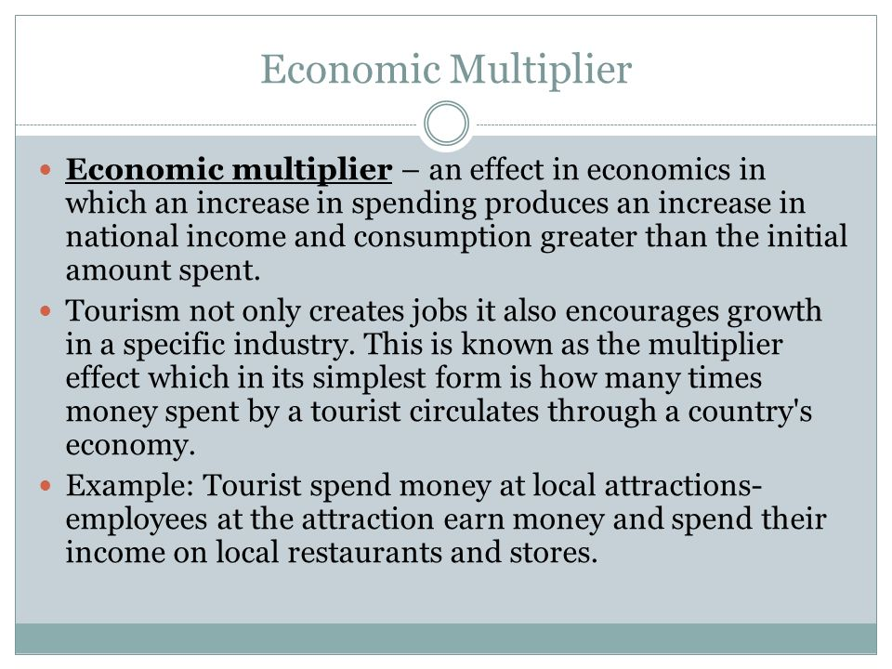
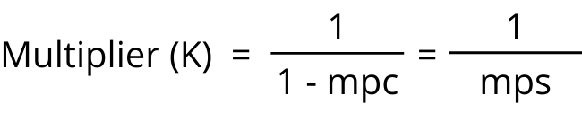
mpc = marginal propensity to consume = change in consumption due to change in income.
mps = marginal propensity to save =change in saving due to change in income
Notes:
Imagine a farming community where there are only a few families. The farmers produce crops and sell them to the local market. Let's say each farmer sells their crops for Rs. 1000 per month, and they collectively spend Rs. 3000 per month at the local grocery store, owned by Mr. Patel, to buy various goods for their households.
Now, let's say there's a bumper crop yield, resulting in higher incomes for the farmers. Each farmer now earns an additional Rs. 500 per month from selling their surplus crops. Rather than saving this extra income, they decide to spend it at Mr. Patel's store.
Here's how this change in consumption can have a multiplier effect:
Initial increase in consumption: Each farmer spends an additional Rs. 500 at Mr. Patel's store compared to before.
Increased revenue for Mr. Patel: Mr. Patel sees a boost in his revenue by Rs. 1500 from the increased spending by the farmers.
Mr. Patel's spending: Encouraged by the increase in revenue, Mr. Patel decides to spend some of his extra income. Let's say he spends Rs. 1000 on purchasing additional stock for his store from a distributor.
Distributor's income: The distributor, now receiving Rs. 1000 more income, decides to spend some of it. Let's say they spend Rs. 800 on repairing their delivery vehicle.
Vehicle repair shop's income: The vehicle repair shop, receiving Rs. 800 more income, also spends a portion of it. Let's say they hire a part-time mechanic for Rs. 400.
Multiplier effect continues: This process continues with each additional spending leading to further rounds of spending, creating a ripple effect throughout the local economy.
In this example, the initial increase in consumption by Rs. 500 per farmer led to additional rounds of spending and economic activity, ultimately resulting in a larger overall impact on the local economy. This illustrates how changes in consumption can have a multiplier effect by stimulating economic activity and generating additional income.
Sure, let's use a simple example to illustrate the multiplier effect in rupee terms and incorporating the marginal propensity to consume (MPC).
Let's assume that the government decides to provide a stimulus of Rs. 1000 crore to the economy to boost consumer spending. The MPC is the fraction of additional income that households spend. Let's say the MPC is 0.75, meaning that for every additional rupee of income, households spend 75 paise and save 25 paise.
Here's how the multiplier effect works in this scenario:
Initial spending: The government injects Rs. 1000 crore into the economy as a stimulus.
First-round spending: When households receive this additional income, they spend 75% of it (MPC = 0.75) and save the remaining 25%. So, households spend Rs. 750 crore (0.75 × Rs. 1000 crore) on goods and services.
Second-round spending: The businesses that receive Rs. 750 crore in revenue from increased consumer spending now have more income. Let's assume they have a marginal propensity to consume of 0.80. So, they spend 80% of this income on additional goods and services, which amounts to Rs. 600 crore (0.80 × Rs. 750 crore).
Subsequent rounds: This process continues as each round of spending leads to additional rounds of spending. Each time, the amount spent decreases slightly as households save a portion of their income and leakages occur (in the form of taxes, imports, etc.). However, the total increase in economic activity exceeds the initial injection of Rs. 1000 crore.
The multiplier effect magnifies the impact of the initial spending, as each rupee spent leads to further rounds of spending and increases in economic activity.
If we calculate the total increase in economic activity over several rounds using the multiplier, it will be higher than the initial Rs. 1000 crore injected into the economy. The size of the multiplier depends on factors such as the MPC and leakages from the spending stream, as well as the structure of the economy.

Slide 53
Review Question
Question : If MPC = MPS, then value of multiplier is:
Infinity
One
Equal to MPC
Two
Notes:
Answer: D

Slide 54
Review Question
Question: If saving function of an economy is given as: S = -40 + 0.4 (Y), then MPC is:
1
0.4
0.6
None of these
Notes:
Ans. C

Slide 55
Review Question
Question : If MPC = 0.75 and as a result of Multiplier Effect, National Income increased by ₹300 crores by an additional investment of __ .
400 crore
225 crore
1200 crore
75 crore
Notes:
Ans. D

Slide 56
